Slide 1
组会

Slide 2
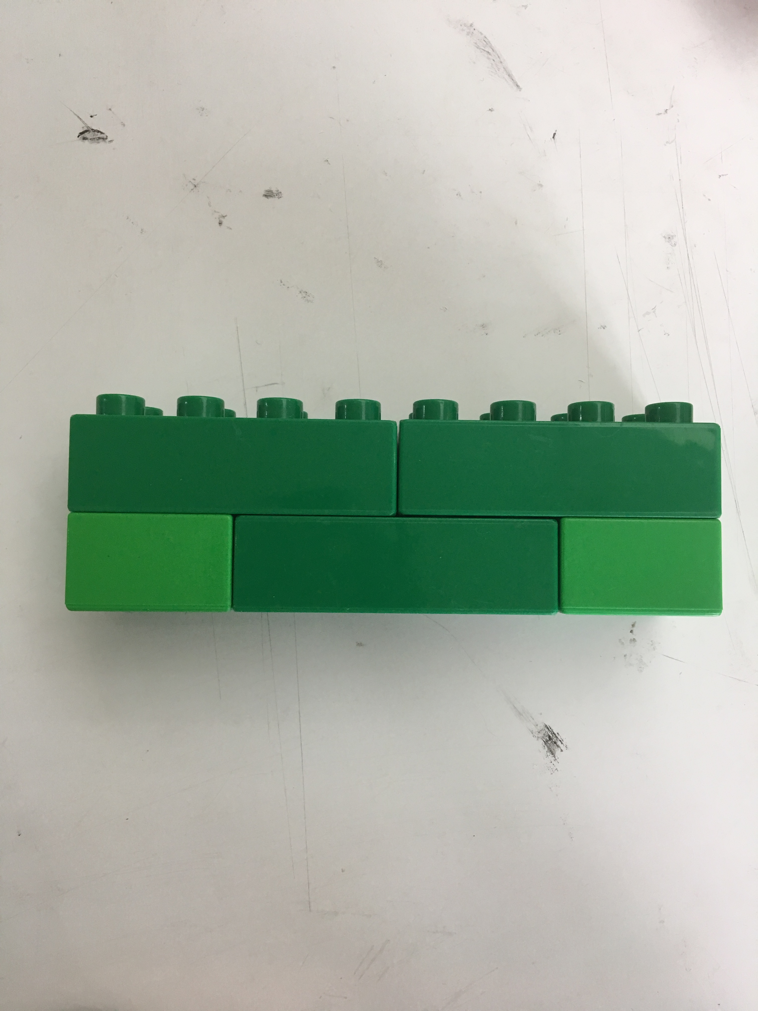
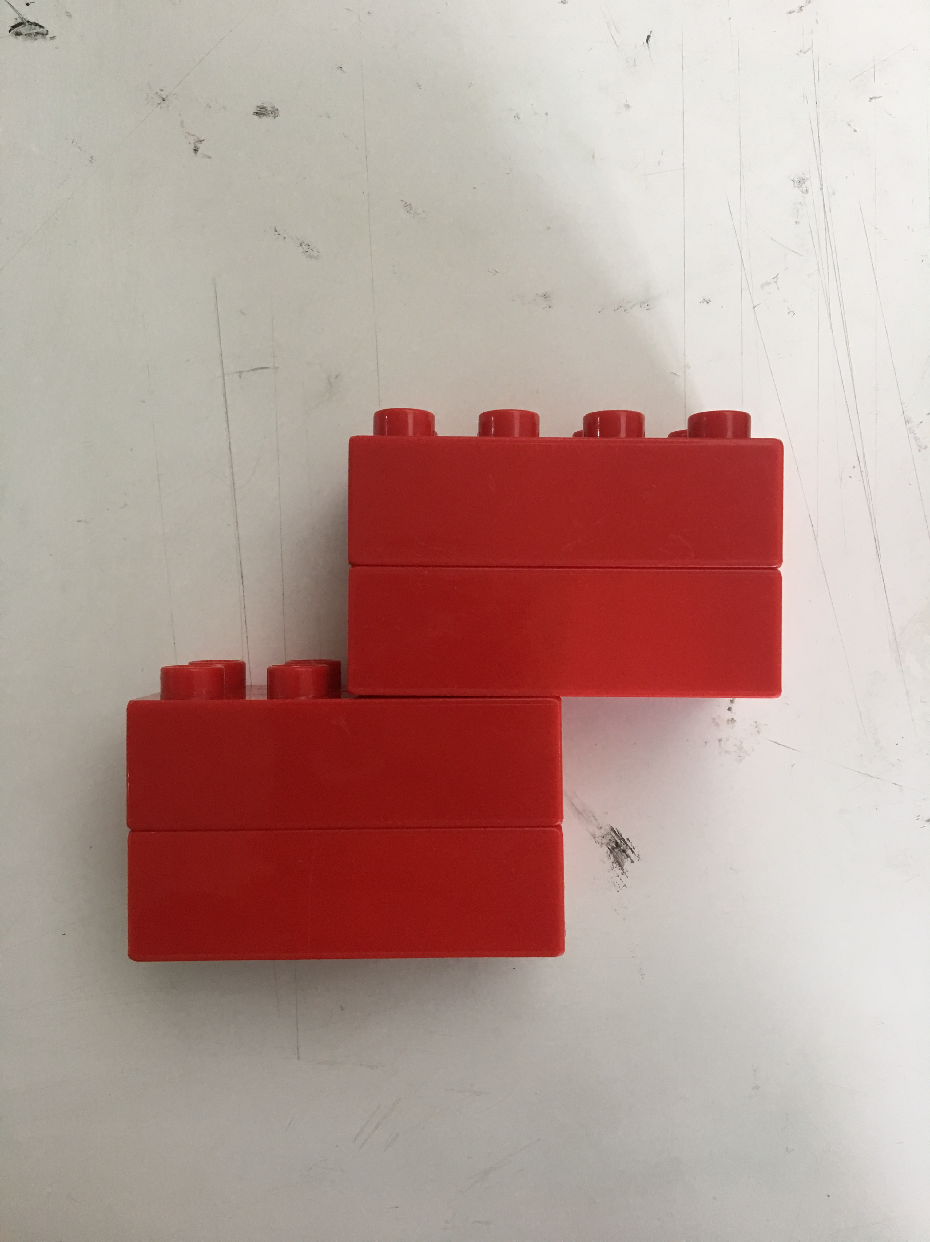
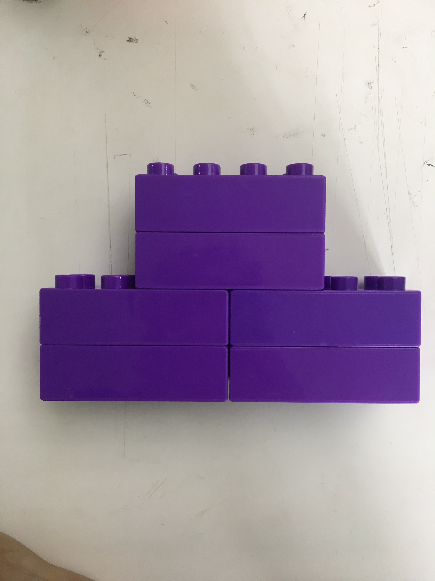
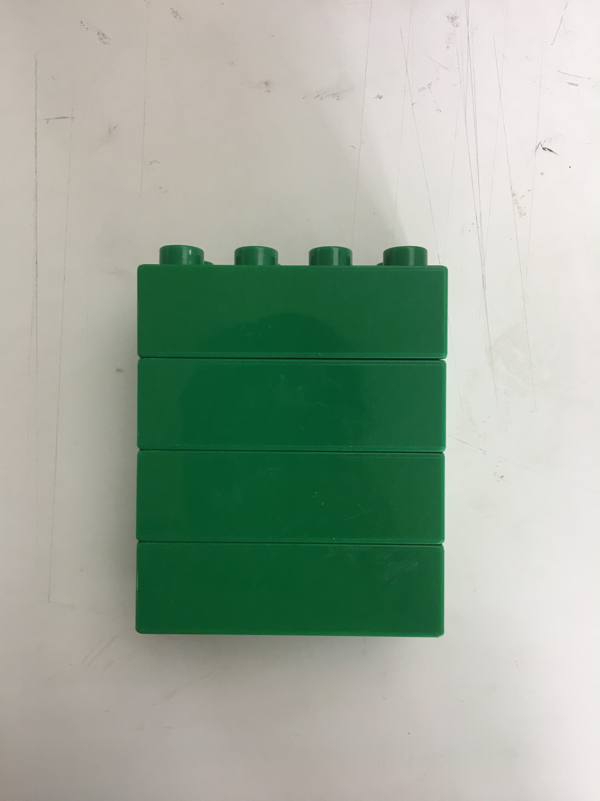

Slide 3
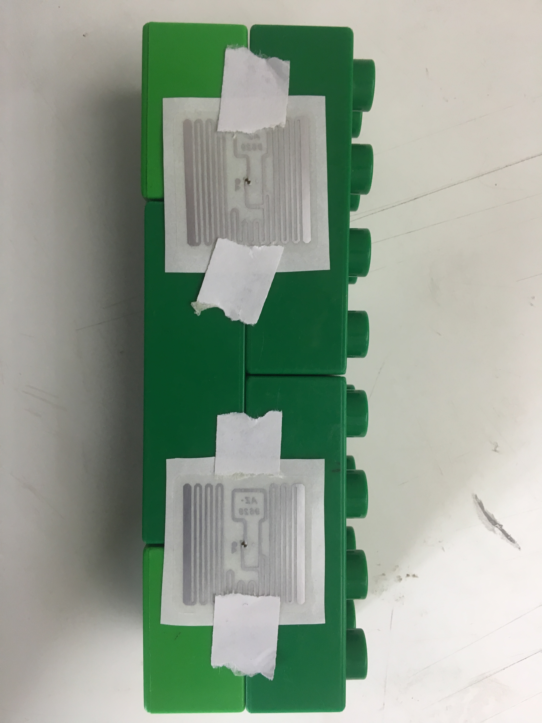
5
4
4
5

Slide 4
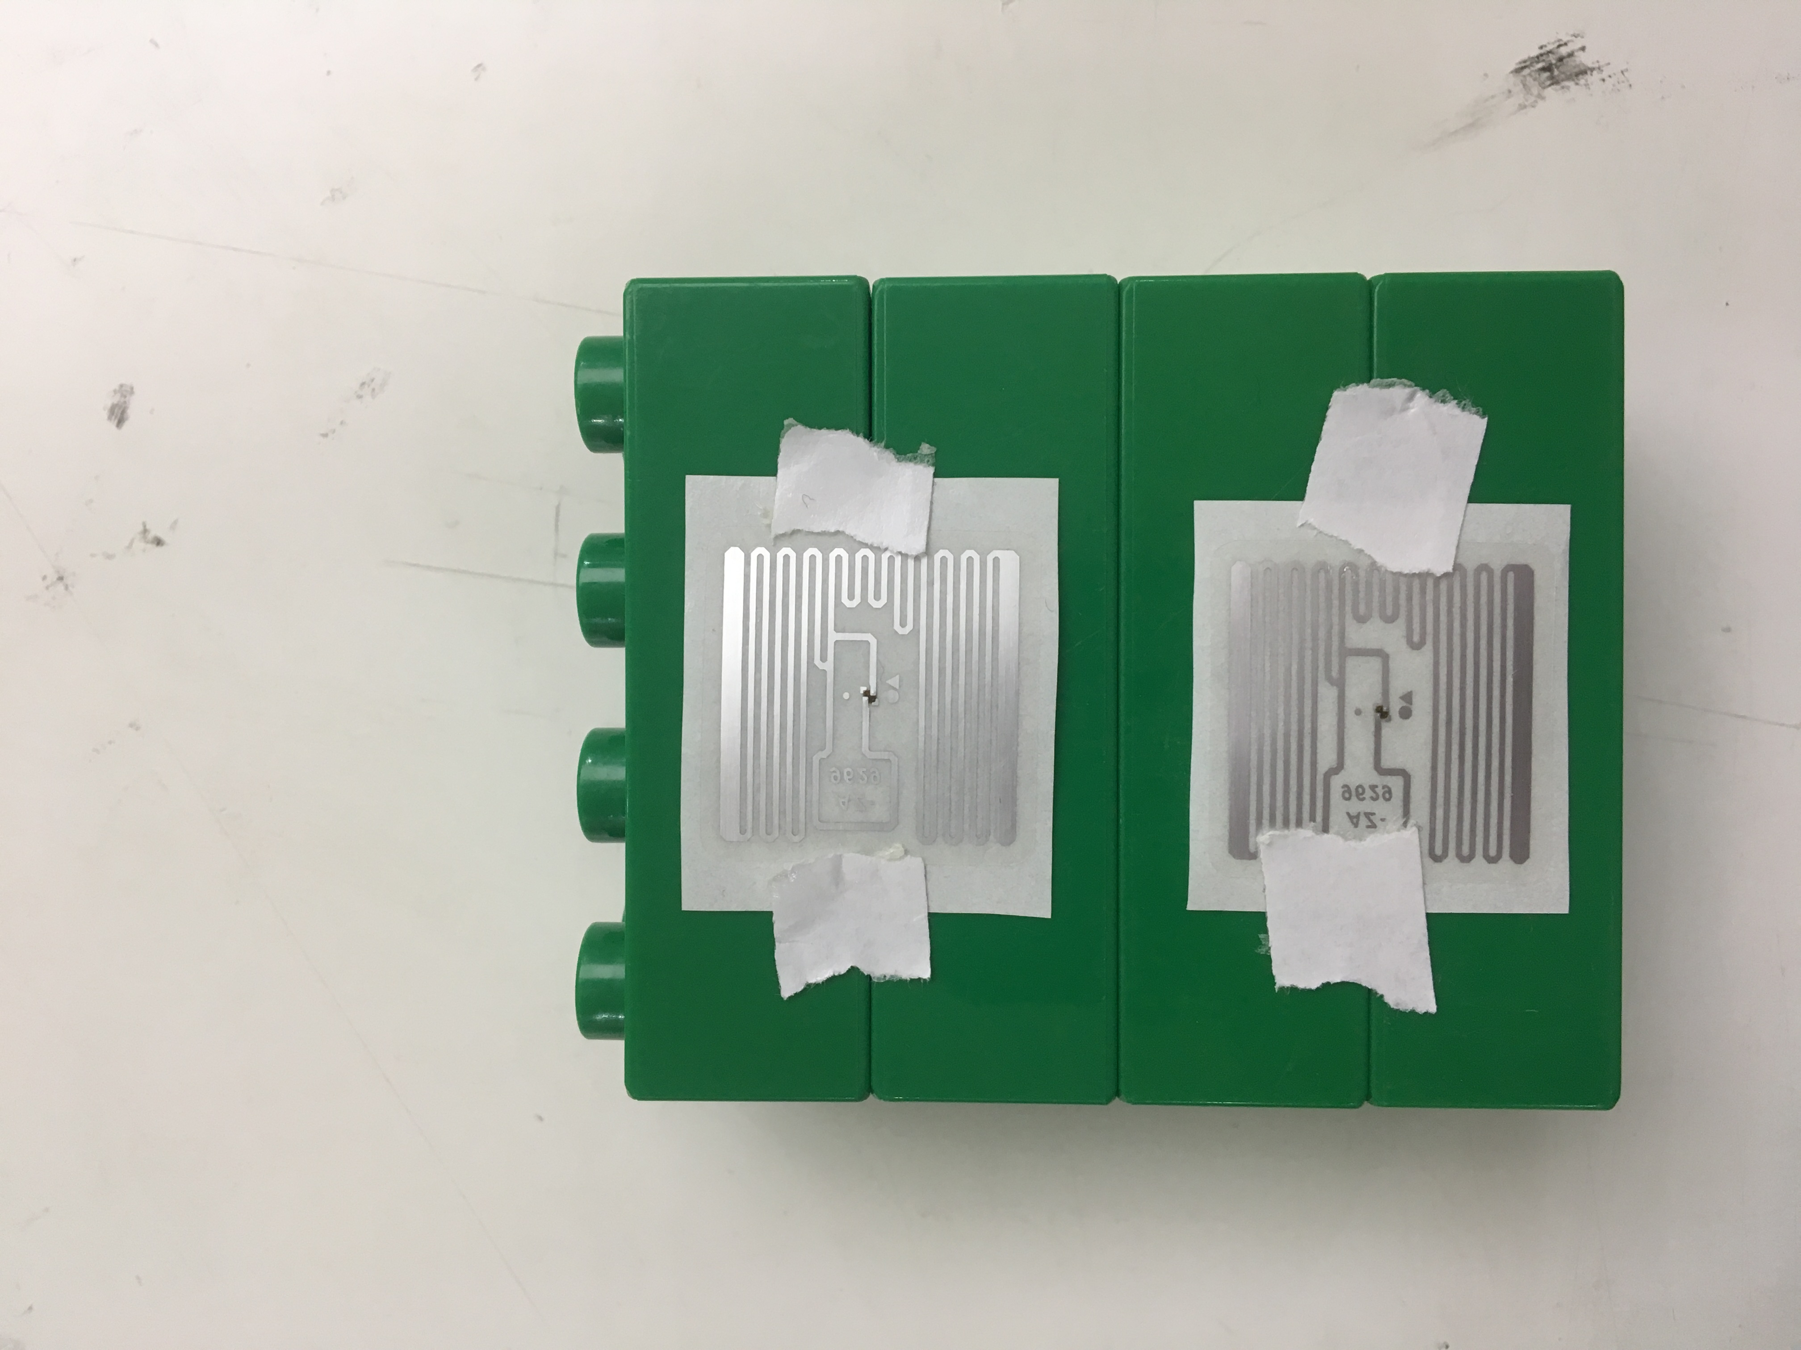
9
10
10
9

Slide 5
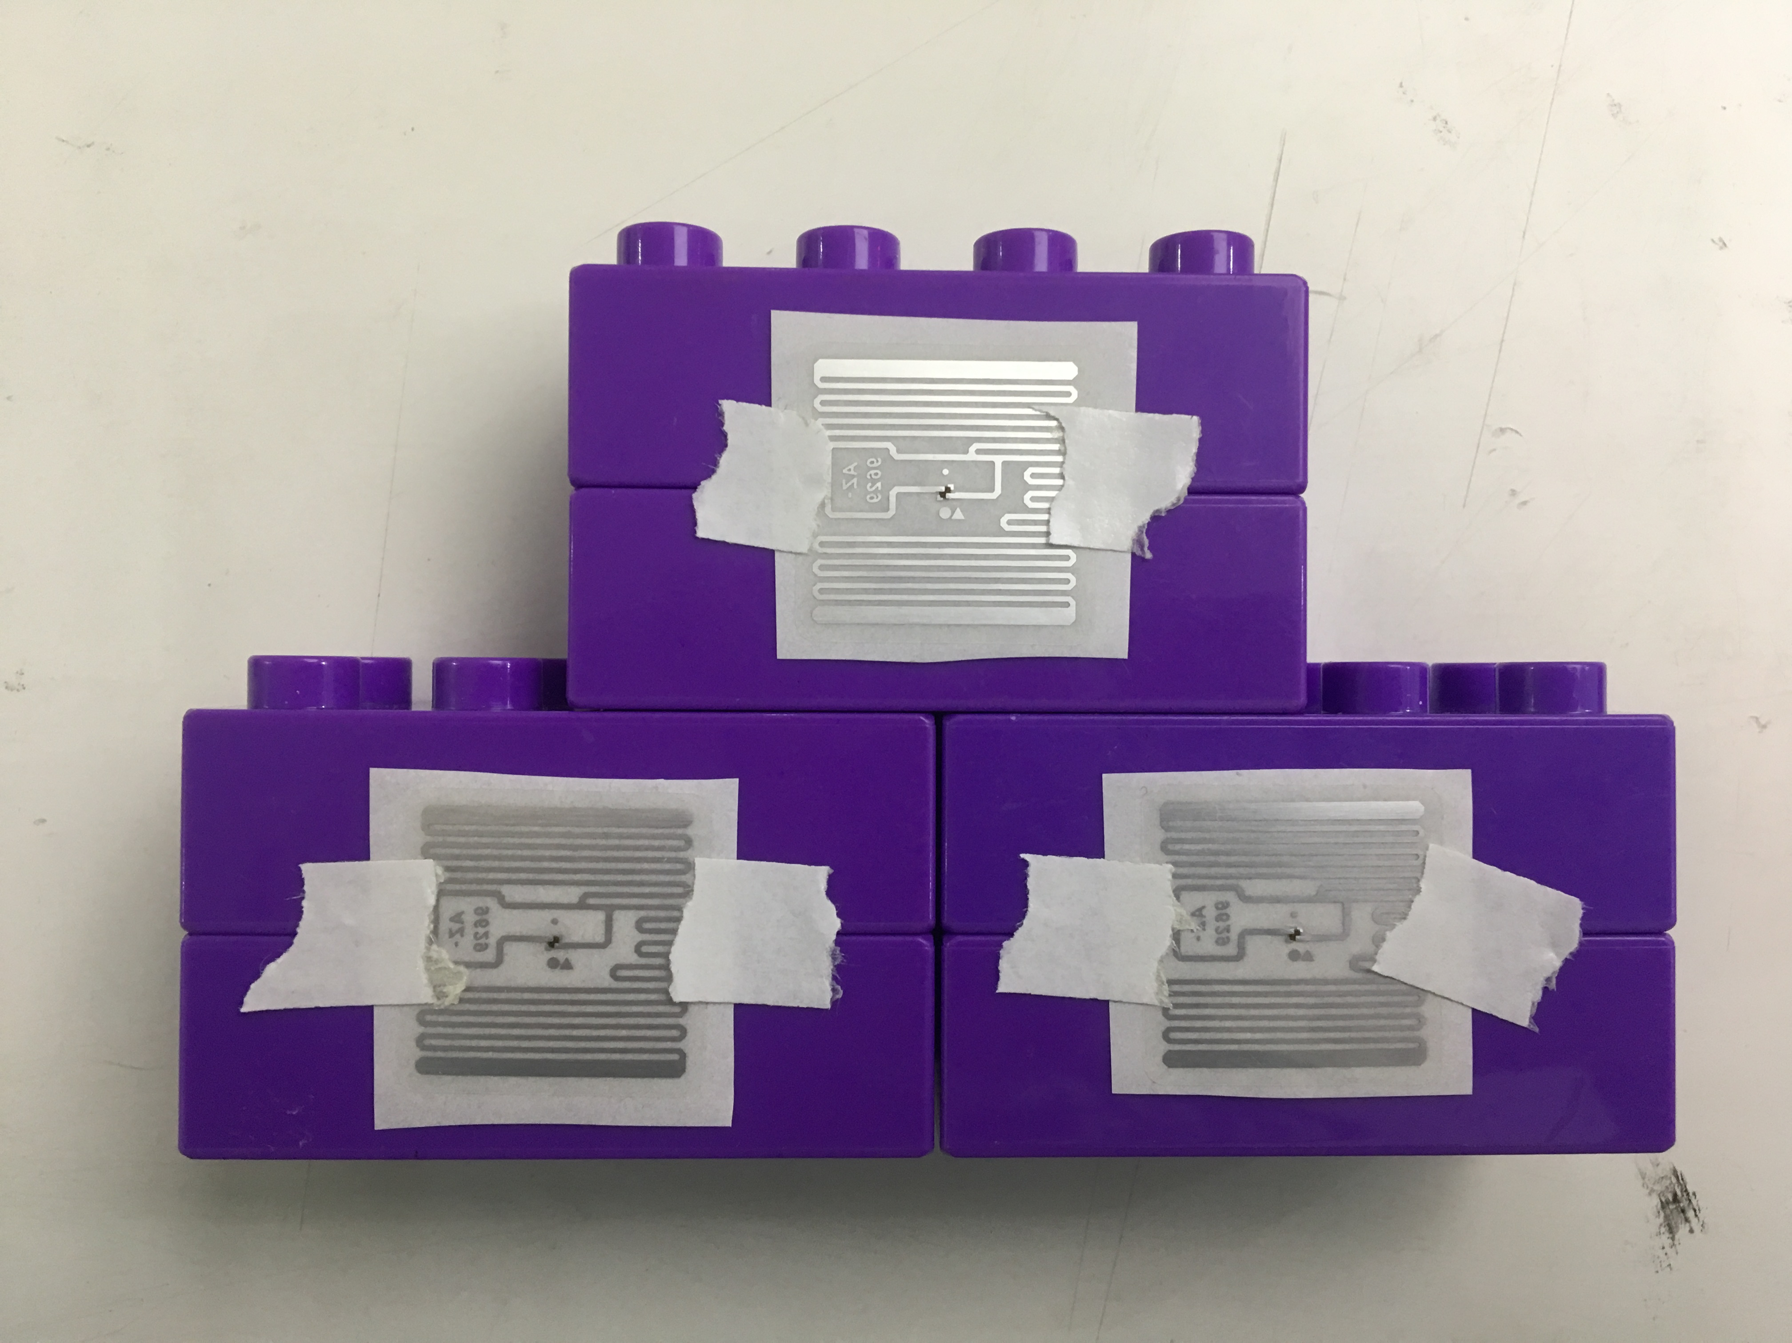
7
8
7
6
8
6
8
6
6
7
7
8

Slide 6
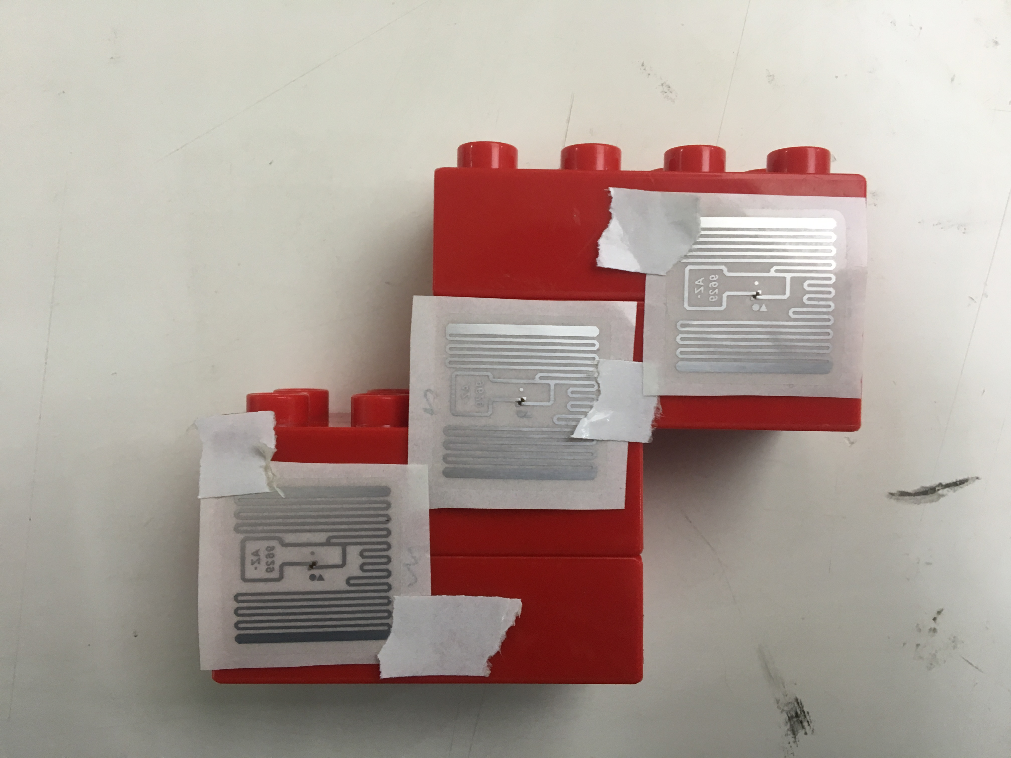
Tag | Rssi
1 | -46
2 | -46.5
3 | -45.5
1
2
3
Tag | Rssi
1 | -49.5
2 | -46.5
3 | -43.5
1
2
3

